Slide 1
Heterotrophic bacteria and the Aggregation of Prochlorococcus in Proterozoic oceans
Celeste Delaune

Slide 2
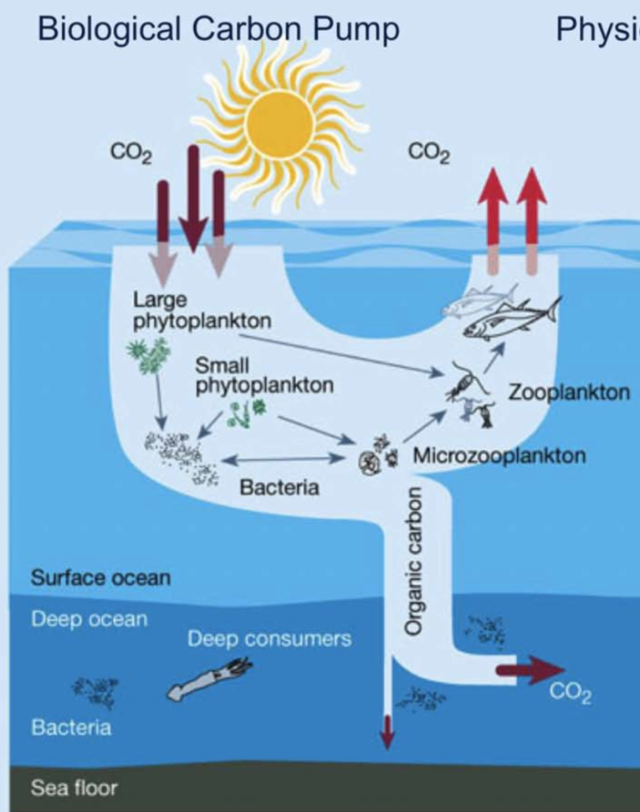

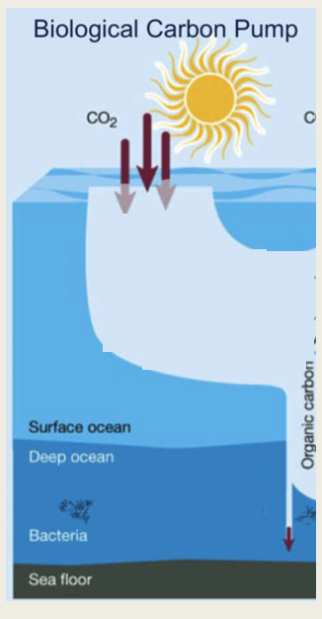

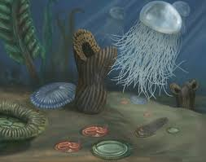
Introduction
Modern Oceans
Proterozoic Oceans
Importance of oceanic biological carbon pump
Primary production and Prochlorococcus marinus
Modern oceans vs. Proterozoic oceans
Bacteria
Bacterial aggregates
Organic carbon
Fig.1. Smithsonian- Proterozoic Ocean

Slide 3
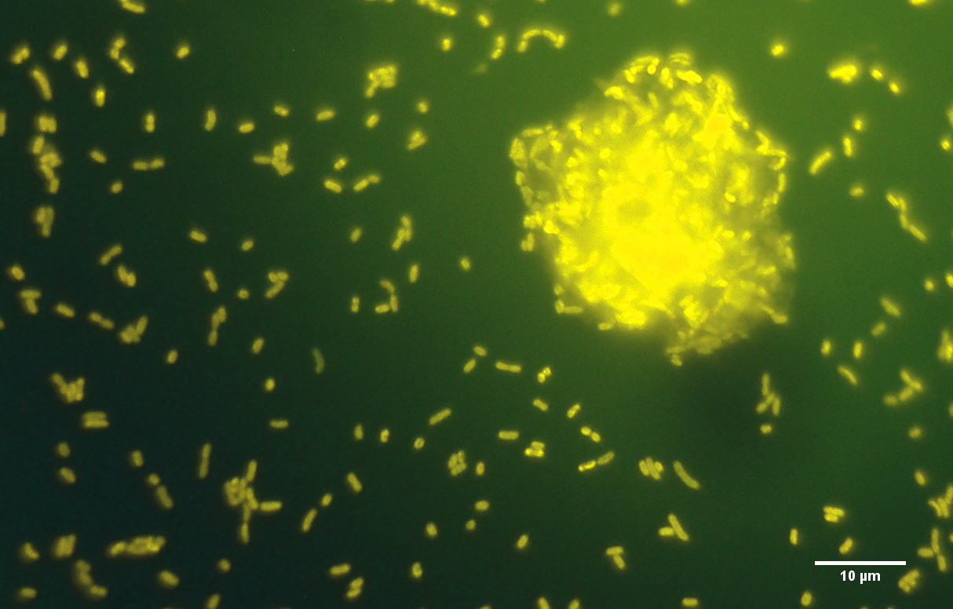
Objectives
Axenic Synechococcus
Prochlorococcus as a model organism
  Sole primary producers
  Primary source of organic carbon in the ocean
Importance of bacterial aggregation
Marinobacter adhaerens and Marinobacter Salsuginis
Experimental hypothesis
Xenic Prochlorococcus
Source: Bianca Cruz
Source: Bianca Cruz

Slide 4
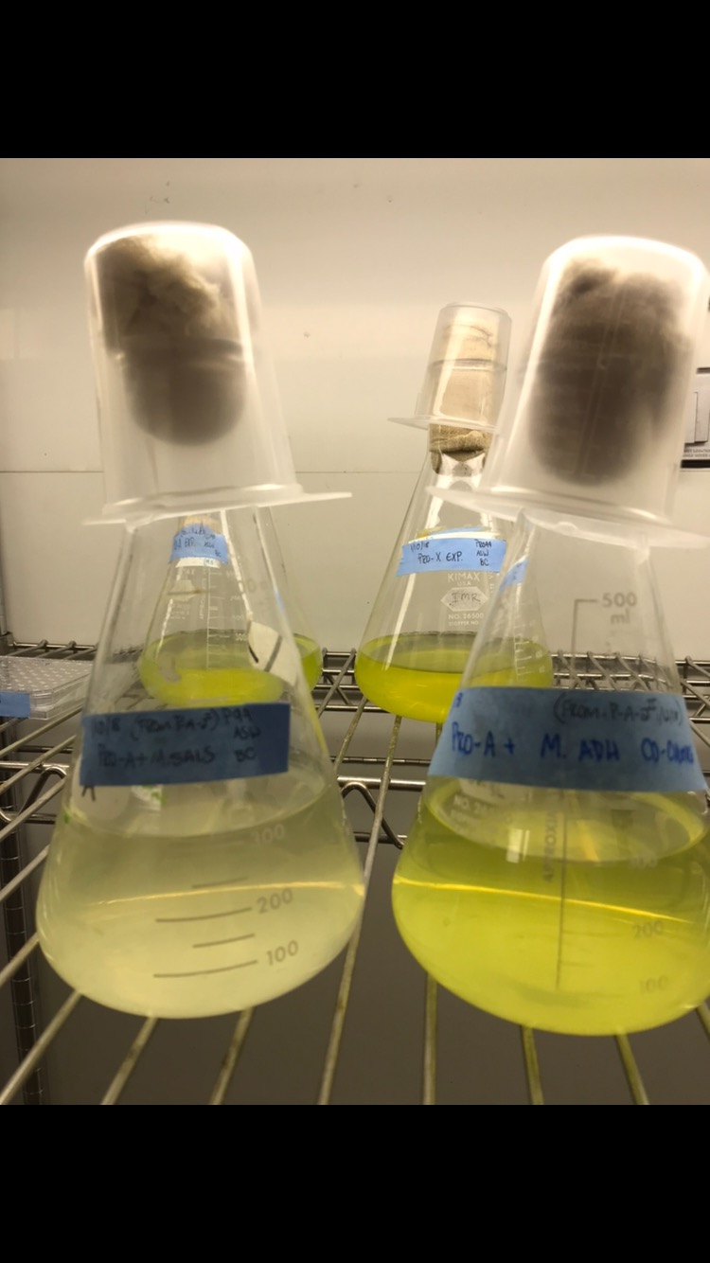
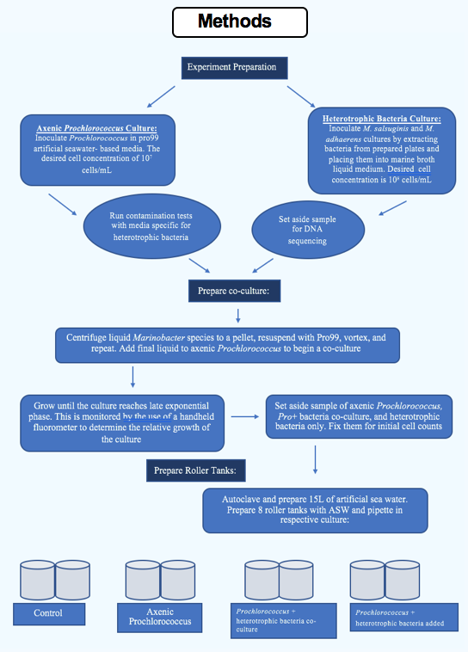
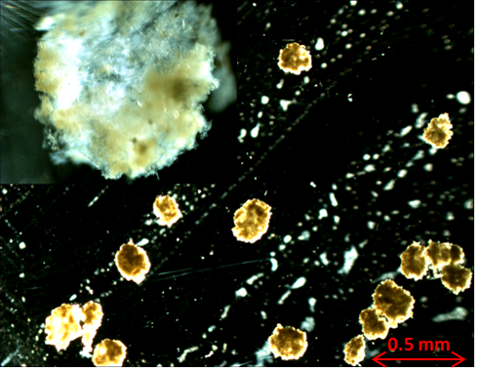
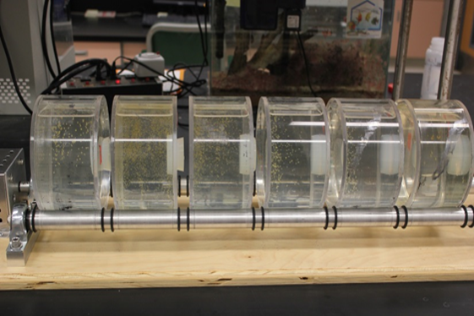
Methods
Source: Bianca Cruz

Slide 5
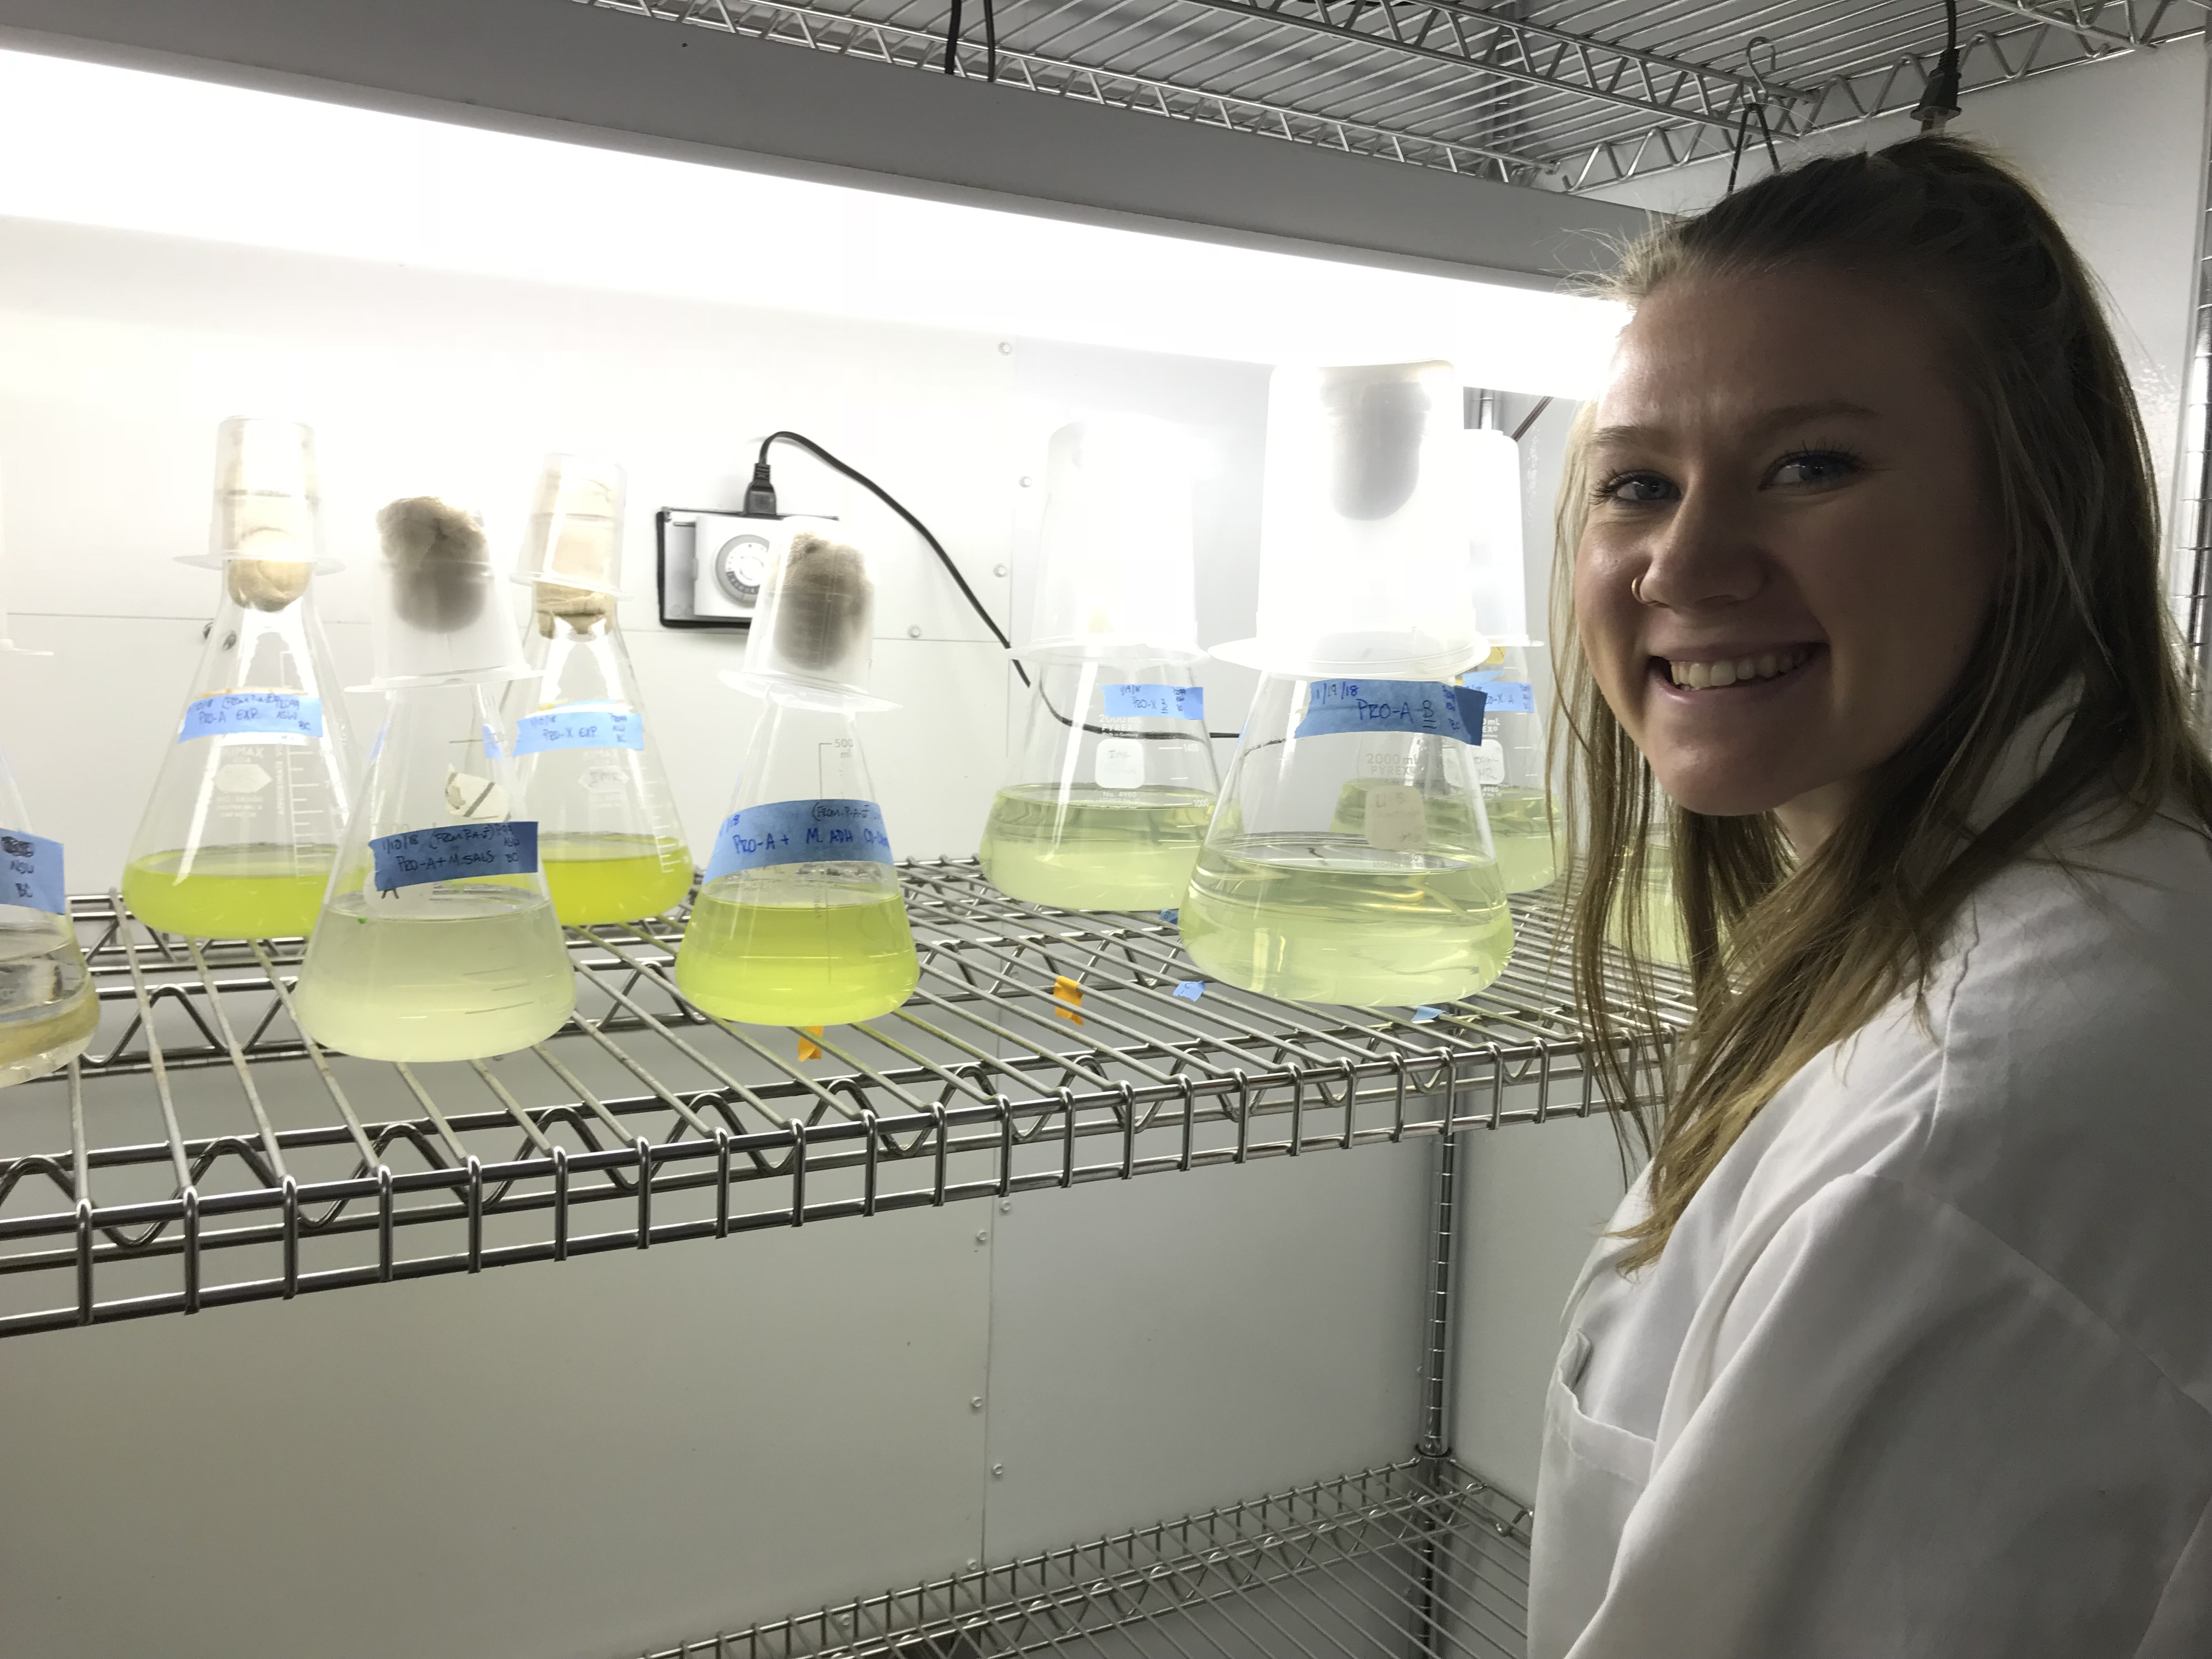
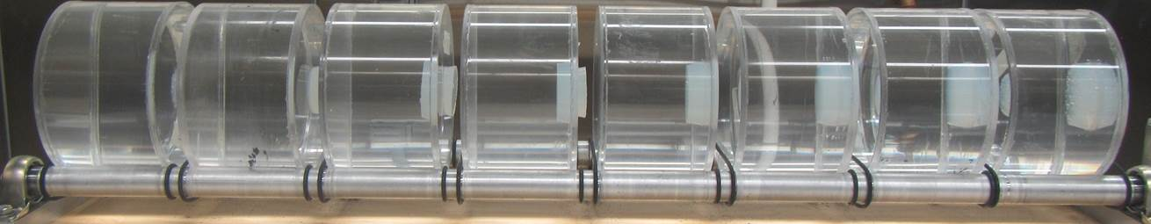
Results
Unexpected results
  Variations in concentration of bacteria or media type
Current control and growth experiments

Slide 6
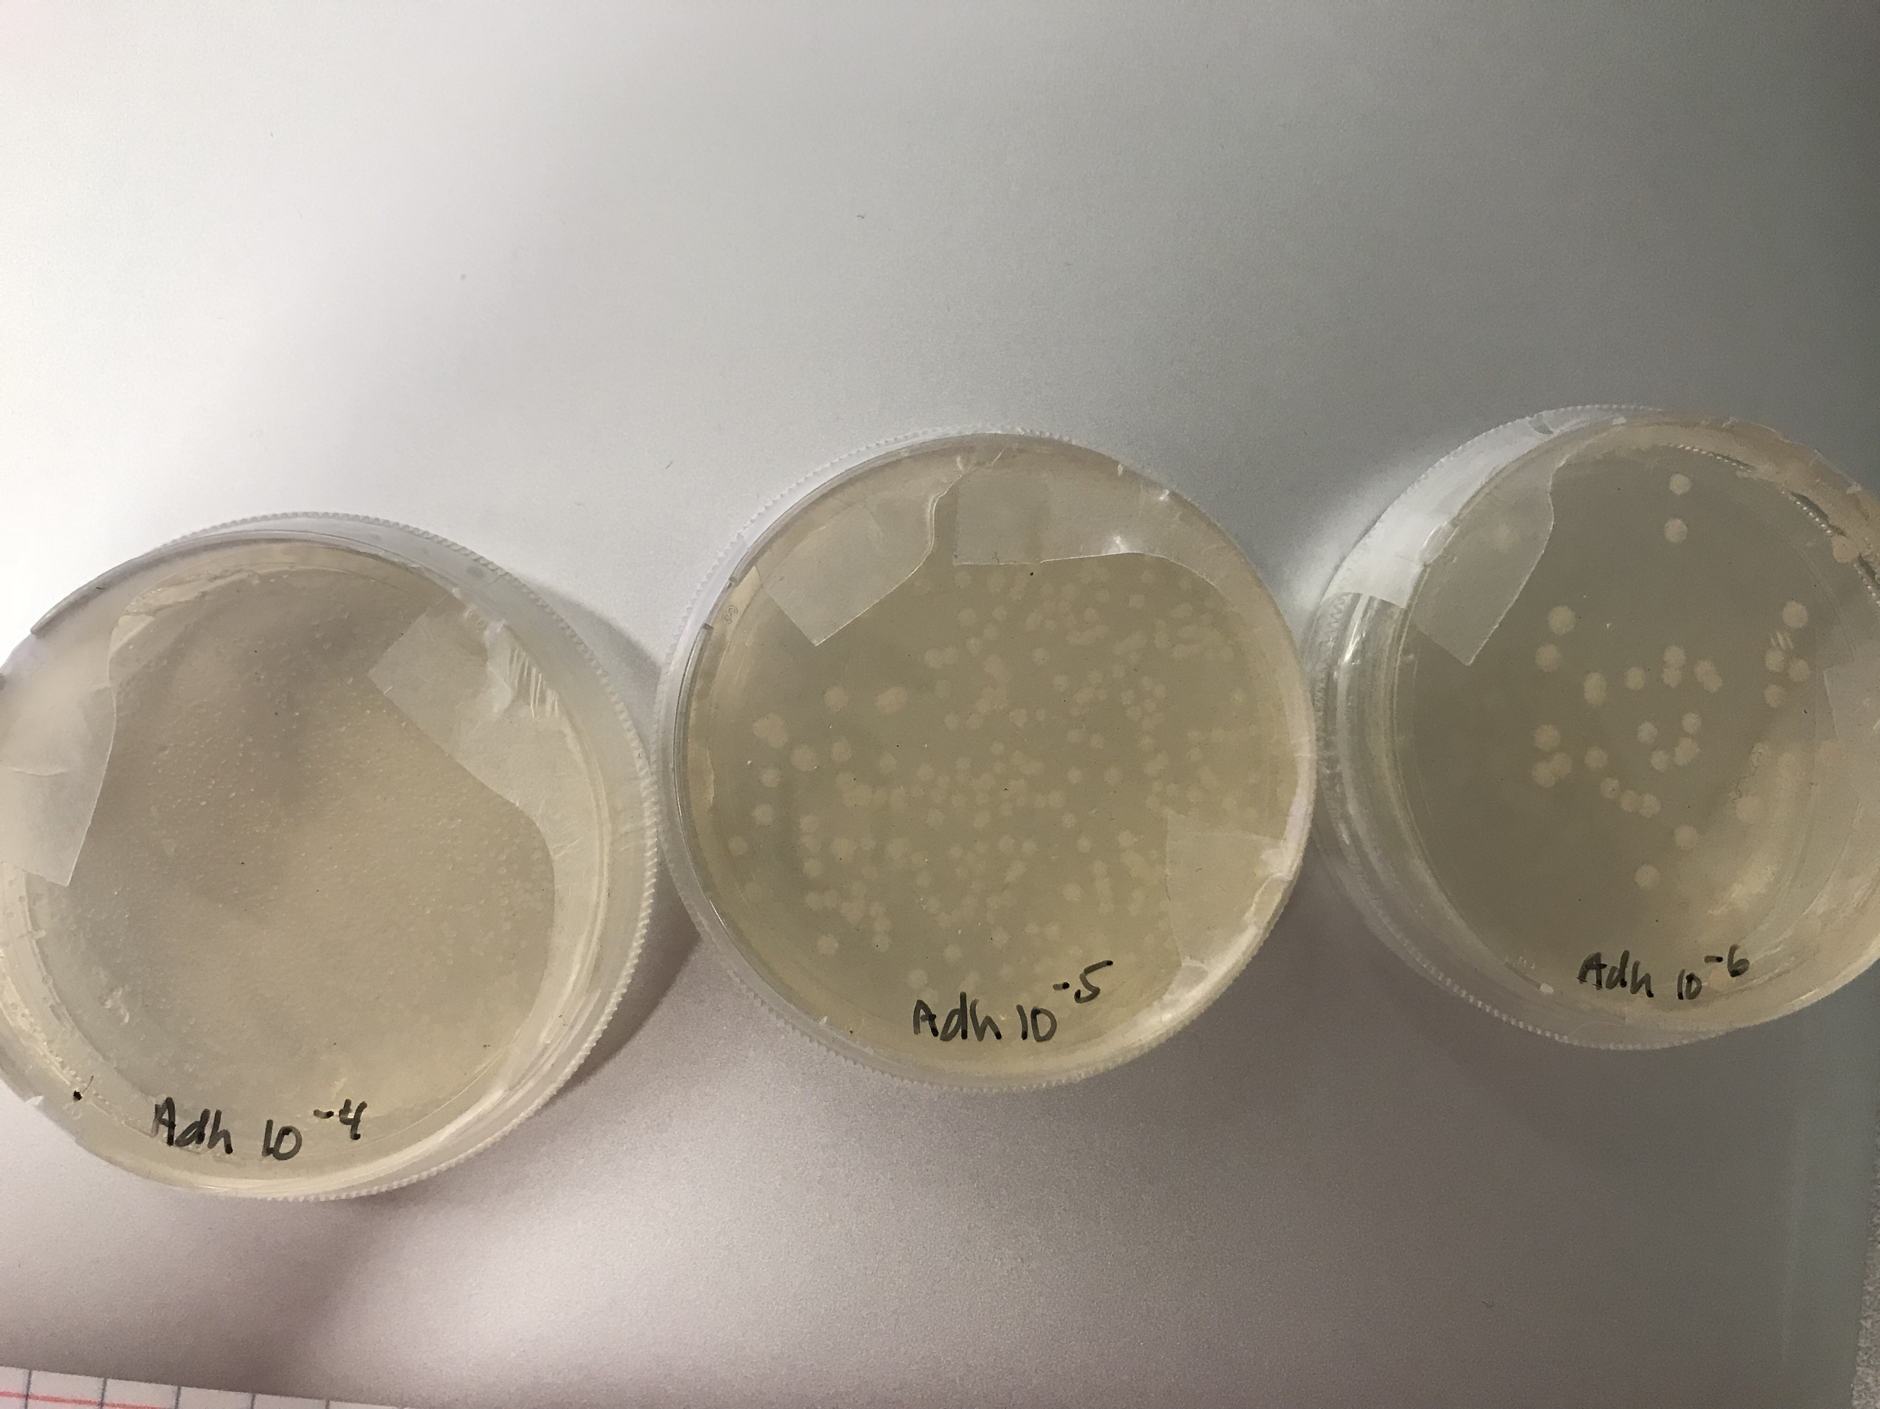
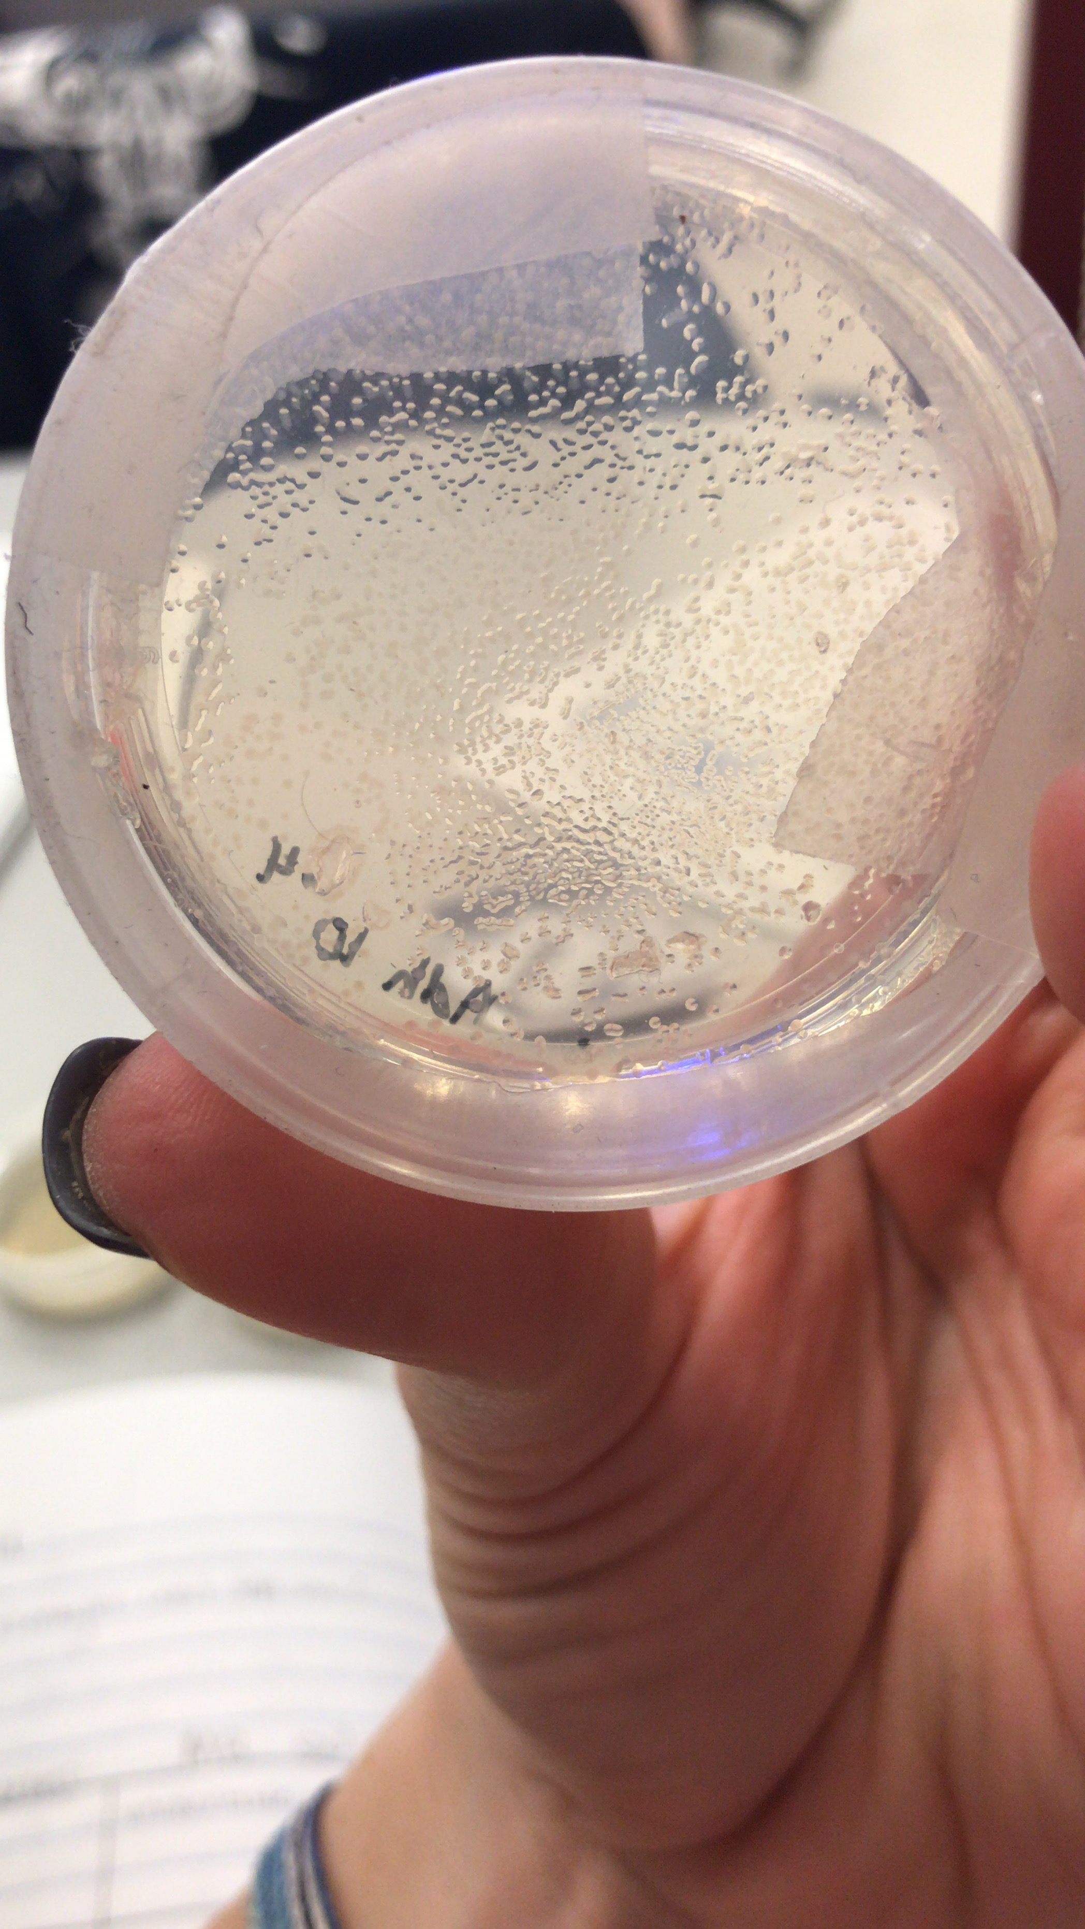
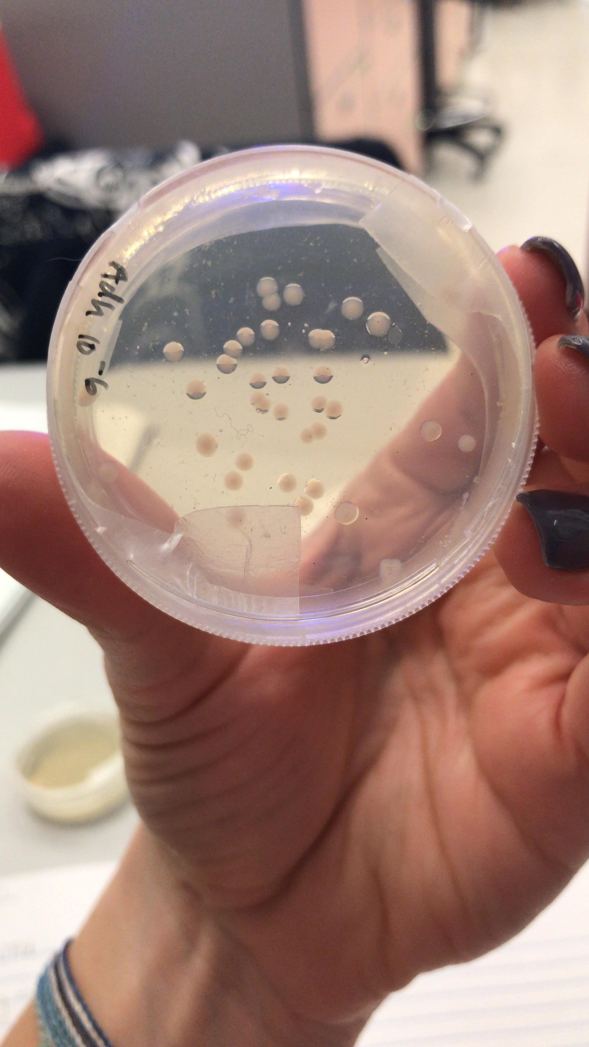
Current Research
    Determining the ideal concentration for roller-tanks
    Techniques for growth experiments
    OD readings, serial dilutions, slides

Slide 7

Acknowledgements
Many thanks to:
Dr. Susanne Neuer
ASU/NASA Space Grant
National Science Foundation

Slide 8
Questions?

